Slide 1





Social Media Analysis
Project
By -ujjwal
DS May 2024

Slide 2


Agenda
What is Meta ?
User Segmentation
Problem Statement
Content Performance
Data Overview
Marketing Strategy
Methodology
Ad Campaigns & Financial Projections
Engagement metrics
Insights and recommendations
Conclusion

Slide 3


Meta
When Facebook launched in 2004, it changed the way people connect. Apps like Messenger, Instagram and WhatsApp further empowered billions around the world. Now, Meta is moving beyond 2D screens toward immersive experiences like augmented, virtual and mixed reality to help build the next evolution in social technology.

Slide 4

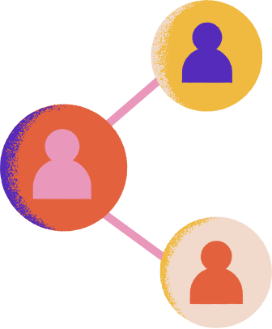


Problem Statement
You are hired as a data analyst at Meta and asked to collaborate with Marketing team. Marketing teams wants to leverage Instagram's user data to develop targeted marketing strategies that will increase user engagement, retention, and acquisition.
Provide insights and recommendations to address the following objectives

Slide 5
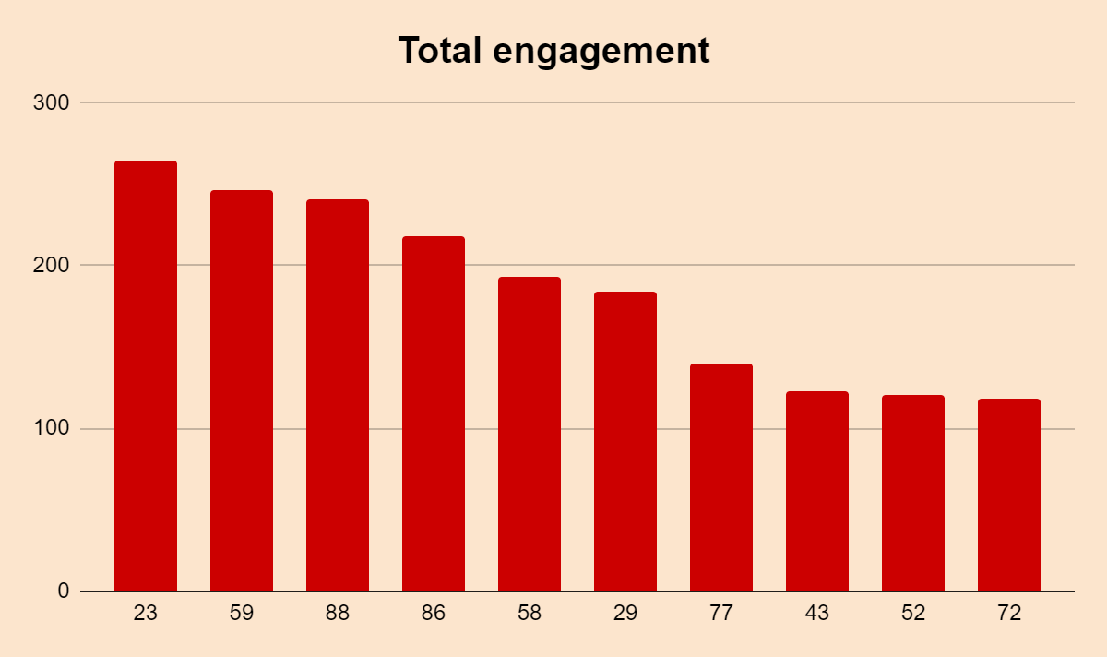

Data Overview
Number of users are 100
Number of tables is 7
Total number of Posts is 257
Total number of Likes are 8782
Total number of comments on all posts are 7488
Total number of Engagements is calculated by the sum of likes and comments
Number of inactive users 23

Slide 6



Analytical approach
1. Data Cleaning: Remove duplicates and handled null values for accurate analysis.
2. Trend & Engagement: Analyzed trending hashtags and user interactions across content.
3. User Segmentation: Grouped users based on engagement with hashtags and content.
4. Descriptive Stats: Calculated total users, posts, likes, and comments.
5. Visualization: Created charts to highlight trends, top users, and key hashtags.

Slide 7
Analysis of objective questions
1. Ideal Influencer Marketing Candidates
By identifying users with high follower counts and engagement rates, businesses can collaborate with the right influencers. Ideal influencers are those with both a large audience and a high level of interaction (likes, comments). These influencers can significantly enhance brand visibility and trust among potential customers.
2. Segmenting Users for Targeted Campaigns
Tool C
fhrfjnrhyutjtf
Segmenting the user base based on behavior, such as content preferences, engagement metrics, and follower counts, allows businesses to target users with personalized recommendations and marketing campaigns. This approach improves user experience, leading to higher conversion rates and user retention.
Write your explanation of the topic here.

Slide 8


3. Measuring Ad Campaign Effectiveness
By analyzing data on ad impressions, clicks, and conversions, you can measure the return on investment (ROI) of marketing campaigns.
Optimizing future campaigns involves understanding which ads perform best, adjusting budgets, and targeting specific user segments for better performance.
Tool C

Slide 9
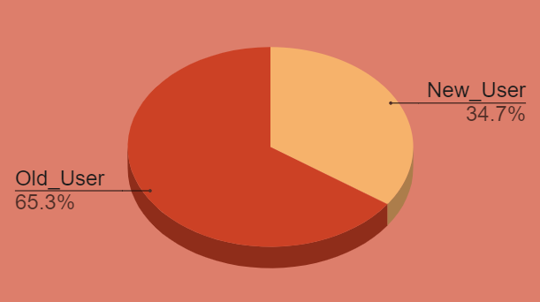
Identifying New and Old Users
3. Measuring Ad Campaign Effectiveness
fhrfjnrhyutjtf
Segmenting users into "new" and "old" groups based on registration date allows for more targeted marketing efforts. New users can be guided with onboarding strategies, while old users can be retained through re-engagement and loyalty programs, resulting in sustained growth and retention.
Tool C
65% of the current total users are old users. (Joined before 2017)
Remaining 35% users are New means
They joined after 2017.

Slide 10

Market Segmentation
Objectives: Customize marketing efforts for personalization, target specific user groups, enhance engagement, and optimize resource use.
Key Criteria: Segment users based on demographics, behavioral data, engagement metrics, psychographics, and RFM analysis.
Segmentation Strategies: Implement activity-based, engagement-based, behavioral, and demographic segmentation.
Implementation Steps: Collect user data, analyze patterns, design targeted campaigns, and continuously monitor and adjust strategies.
Conclusion: Effective segmentation improves user understanding, enhances marketing efficiency, and drives better engagement and results.

Slide 11
Content Effectiveness
Engagement Focus: Identify which content receives the most engagement and create more of that type. Prioritize successful themes like "dreamy" and "beauty."
Hashtag Effectiveness: Evaluate hashtag performance by calculating average likes. Top hashtags "dreamy" (35.75%) and "beauty" (34.95%) drive the most engagement.
Improvement Areas: Address lower engagement areas, like "landscape" (33.59%). Enhance content or hashtag strategy to boost performance in these areas.

Slide 12

Ad Strategy
1. Personalized Ad Content: Use user data to tailor ad content based on their consumption patterns. Provide recommendations and notifications relevant to their interests and preferences.
2. Segment-Based Campaigns: Run ad campaigns targeting specific user segments according to their categories and engagement levels. Customize ads to align with each segment's needs and behaviors.
3. Engage Influencers: Collaborate with highly engaged users like Karley_Bosco, Kenneth 64, and Erick 5 to create compelling content. Leverage their influence to motivate and re-engage other users on the platform.chnology.

Slide 13
Insights and recommendations
Insights:
Hashtag Impact: Posts with trending hashtags drive higher engagement.
Content Type Efficiency: Photos are less time-consuming compared to reels and videos.
Holiday Trends: Travel photos see increased engagement during holidays.
Recommendations:
Content Balance: Prioritize reels for higher engagement while maintaining a balanced content strategy.
Trend Monitoring: Focus on current trends and continuously adjust content strategies to stay relevant.
Hashtag Optimization: Regularly update hashtags to align with trending topics and boost engagement.

Slide 14

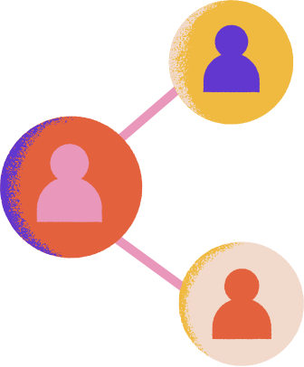
Conclusion
Leverage High Engagement: Utilize top users like Karley_Bosco and Kenneth_64 to boost interaction.
Optimize Hashtags: Focus on effective hashtags like #Smile and #Beach, and keep them updated with trends.
Replicate Success: Analyze and use successful content strategies from high-engagement posts.
Boost Less Engaged Users: Prioritize strategies to increase activity among Less Engaged users.
Promote Reels: Encourage reel creation and use trending hashtags to enhance engagement.

Slide 15
THANK YOU

